Slide 1


KS4 Mathematics
N1 Classifying Numbers

Slide 2

Classifying numbers
Natural numbers
Positive whole numbers 0, 1, 2, 3, 4 …
Integers
Positive and negative whole numbers … –3, –2, 1, 0, 1, 2, 3, …
Rational numbers
Numbers that can be expressed in the form ^{n}/_{m}, where n and m are integers. All fractions and all terminating and recurring decimals are rational numbers, for example, ¾, –0.63, 0.2.
.
Irrational numbers
Numbers that cannot be expressed in the form ^{n}/_{m}, where n and m are integers. Examples of irrational numbers are π and √2.
Notes:
This slide gives the sets of numbers that pupils have met so far. All off these sets belong to the set of real numbers. Pupils are not required to know about complex numbers at this level.
Explain that natural numbers are also called counting numbers. This is the most basic set of numbers.
Rational numbers (from the word ratio) can be written as one integer divided by another, as a terminating decimal or as a recurring decimal. Remind pupils that all terminating and recurring decimals can be written as fractions.
Irrational numbers cannot be written exactly as fractions or decimals. As fractions they would consist of an infinitely long string of non-repeating digits.
See N4.2 Terminating and recurring decimals

Slide 3
Even numbers
Even numbers are numbers that are exactly divisible by 2.
For example, 48 is an even number. It can be written as
48 = 2 × 24.
All even numbers end in 0, 2, 4, 6 or 8.
Even numbers can be illustrated using dots or counters arranged as follows:
E(1) = 2
E(2) = 4
E(3) = 6
E(4) = 8
E(5) = 10
The n^{th} even number can be written as E(n) = 2n.
Notes:
Numbers that that can be illustrated using patterns of evenly spaced dots or counters are called figurate numbers. Pupils no not need to remember this term, however.
Examples of figurate numbers include even numbers, odd numbers, triangular numbers, square numbers and cube numbers.
Illustrating numbers using patterns of dots help us to deduce and justify their properties.
Explain that we can use the notation E(1) to mean the first even number, E(2) to mean the second even number, E(3) to mean the third even number, and so on. We can also write E₁, E₂, E₃, …
Of course, although (half of) even numbers are negative, these cannot be shown as a pattern of dots.

Slide 4
Odd numbers
Odd numbers leave a remainder of 1 when divided by 2.
For example, 17 is an odd number. It can be written as
17 = 2 × 8 + 1
All odd numbers end in 1, 3, 5, 7 or 9.
Odd numbers can be illustrated using dots or counters arranged as follows:
U(1) = 1
U(2) = 3
U(3) = 5
U(4) = 7
U(5) = 9
The n^{th} odd number can be written as U(n) = 2n – 1.
Notes:
Explain that odd numbers can also be negative even though they cannot be shown figuratively in this way.

Slide 5
Triangular numbers
Triangular numbers are numbers that can be written as the sum of consecutive whole numbers starting with 1.
For example, 15 is a triangular number. It can be written as
15 = 1 + 2 + 3 + 4 + 5
Triangular numbers can be illustrated using dots or counters arranged in triangles:
T(1) = 1
T(2) = 3
T(3) = 6
T(4) = 10
T(5) = 15

Slide 6
Triangular numbers
Suppose we want to know the value of T(50), the 50th triangular number.
We could either add together all the numbers from 1 to 50 or we could find a rule for the n^{th} term, T(n).
If we double the number of counters in each triangular arrangement we can make rectangular arrangements:
T(1) = 1
T(2) = 3
T(3) = 6
T(4) = 10
T(5) = 15
2T(1) = 2
2T(2) = 6
2T(3) = 12
2T(4) = 20
2T(5) = 30
Notes:
Explain that adding all the numbers from 1 to 50 would be a long task. If we knew the formula for the nth term them we could simply substitute this value
The following slides show the derivation of the n^{th} triangular number using the triangular arrangements and doubling them.

Slide 7
Triangular numbers
Any rectangular arrangement of counters can be written as the product of two whole numbers:
T(1) = 1
T(2) = 3
T(3) = 6
T(4) = 10
T(5) = 15
2T(1) = 2
2T(2) = 6
2T(3) = 12
2T(4) = 20
2T(5) = 30
2T(1) = 1 × 2
2T(2) = 2 × 3
2T(3) = 3 × 4
2T(4) = 4 × 5
2T(5) = 5 × 6
From these arrangements we can see that 2T(n) = n(n + 1)
So, for any triangular number T(n)
n(n + 1)
T(n) =
2
Notes:
Use the rectangular arrangements to help pupils see that two times a triangular number is equal to the product of the term number and the term number plus 1.
Each triangular number is therefore equal to half of the product of the term number and the term number plus 1.

Slide 8
Triangular numbers
We can now use this rule to find the value of the 50th triangular number.
n(n + 1)
T(n) =
2
50(50 + 1)
T(50) =
2
50 × 51
T(50) =
2
2550
T(50) =
2
T(50) = 1275

Slide 9
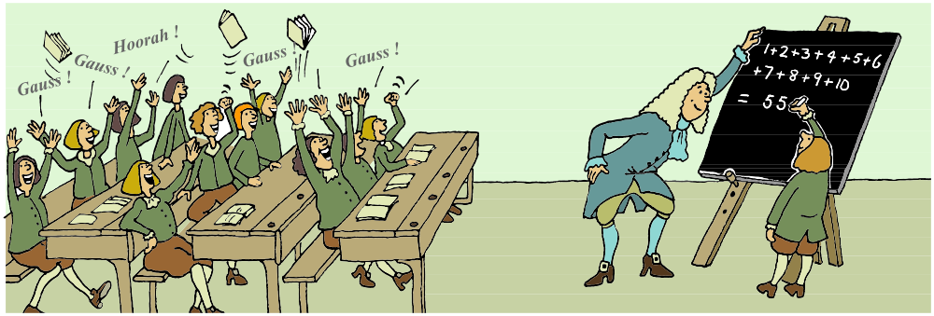
Gauss’ method for adding consecutive numbers
There is a story that when the famous mathematician Karl Friederick Gauss was a young boy at school, his teacher asked the class to add up the numbers from one to a hundred.
The teacher expected this activity to keep the class quiet for some time and so he was amazed when Gauss put up his hand and gave the answer, 5050, almost immediately!
Notes:
Gauss was only six years old when he worked this out. Ask the pupils what kind of number 5050 is. How did Gauss do the calculation?

Slide 10
Gauss’ method for adding consecutive numbers
Gauss worked the answer out by noticing that you can quickly add together consecutive numbers by writing the numbers once in order and once in reverse order and adding them together.
For example, to add the numbers from 1 to 10:
1
+
2
+
3
+
4
+
5
+
6
+
7
+
8
+
9
+
10
10
+
9
+
8
+
7
+
6
+
5
+
4
+
3
+
2
+
1
11
+
11
+
11
+
11
+
11
+
11
+
11
+
11
+
11
+
11
= 110
Sum of the numbers from 1 to 10 = 110 ÷ 2
= 55
Use this method to show that the nth triangular number is:
n(n + 1)
T(n) =
2

Slide 11
Square numbers
Square numbers are obtained when a whole number is multiplied by itself. They are sometimes called perfect squares.
For example, 49 is a square number. It can be written as
49 = 7 × 7 or 49 = 7².
Square numbers can be illustrated using dots or counters arranged in squares:
S(1) = 1
S(2) = 4
S(3) = 9
S(4) = 16
S(5) = 25
Notes:
Pupils should be able to recognise square numbers up to 15² = 225

Slide 12

Making square numbers
The n^{th} square number S(n) can be written as S(n) = n².
There are several ways to generate a sequence of square numbers.
We can multiply a whole number by itself.
For example, 25 = 5 × 5 or 25 = 5².
We can add consecutive odd numbers starting from 1.
For example, 25 = 1 + 3 + 5 + 7 + 9.
We can add together two consecutive triangular numbers.
For example, 25 = 10 + 15
We can find the product of two consecutive even or odd
numbers and add 1.
For example, 25 = 4 × 6 + 1.
Notes:
As a challenge ask pupils to demonstrate the last three methods for generating square numbers using diagrams of dots or algebra.

Slide 13
Difference between consecutive squares
Show that the difference between two consecutive square numbers is always an odd number.
If we use the general form for a square number n², where n is a whole number, we can call the square number following it as
(n + 1)².
The difference between two consecutive square numbers can therefore be written as
(n + 1)² – n² =
(n + 1)(n + 1) – n²
= n² + n + n + 1 – n²
= 2n + 1
2n + 1 is always an odd number for any whole number n.
Notes:
Explain that we can use the general forms of special numbers, such as square numbers and odd numbers as shown here, to prove certain results.

Slide 14
Cube numbers
Cube numbers are obtained when a whole number is multiplied by itself and then by itself again.
For example, 64 is a cube number. It can be written as
64 = 4 × 4 × 4 or 64 = 4³.
Cube numbers can be illustrated using spheres arranged in cubes:
C(1) = 1
C(2) = 8
C(3) = 27
C(4) = 64
C(5) = 125
The n^{th} cube number C(n) can be written as C(n) = n³.
Notes:
Count the number of spheres in each arrangement by multiplying the number of cubes in each layer by the total number of layers.
Link to volume = length × width × height.

